Slide 1

ETHFitness
Health and Fitness “3.0”
Incentivized by ERC20
Proof of Location
Proof of Participation

Slide 2

Idea and Concept
HOW
WHAT
WHY
Using NobeBB and Metamask for User Registration.
APIs enrich data from cross –platform sources.
Payment negotiations through smart contracts
Multi-Phased approach to creating a consumer adopted,
(Insurance funded) health awareness eco-system.
Seed through Gamification of current wearables and apps
Transactions could Monetized through user data; (key market segments, activity types, Location, verified activities, etc.)
Next-generation location awareness powers Proof of Location and Proof of Participation concepts
Immutability – Transparency – Reduce Fraud
Platform Agnostic – Reduces overhead
Trustless – Smart Contracts
Private key providing Data Ownership by users

Slide 3

Race Types and Development Maturity
Real Time Racing (Same Geo)
Casual Users
Virtualized - Cross Platform
Flash Race

Slide 4





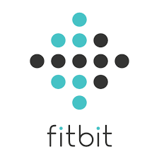


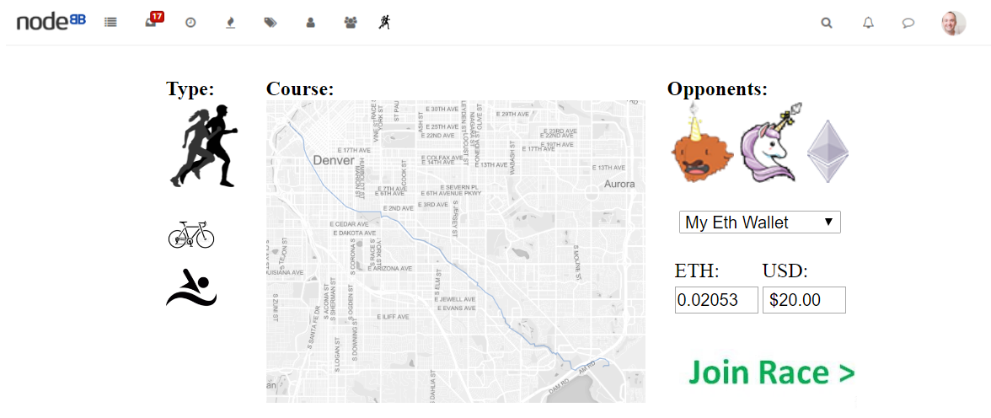
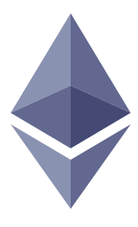
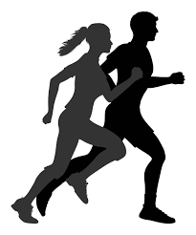
Cross Platform Race Type
Phase 1
Activity Data
APIs will pull in data from whichever platform(s) the user choses to track their race progress and validate their location
GeoMapping
Mapbox is being used as our GeoMapping service and allows for us to display real-time race progress and completion
Cross Platform Races
ETH Tokens
Allow the funds incentive activity to be held in escrow during the event(race), with payouts automatically distributed based on the outcome
Record of Participation
Allows for further gamification of achievements and incentives to drive health and fitness

Slide 6
The Corporate Use Case
Value
Quality
Quantity
FY 2016 Companies with Corporate wellness programs performed 7% higher then the S&P 500.
Decreased Sick Days. CDC Estimates $103/year/Employee
Employee Engagement and Satisfaction.
Cheaper Talent Acquisition
Improves Talent retention
Gamification
60% of corporate organizations either actively running or considering Corporate wellness programs
Motivated → Productivity
Reduced Sick days

Slide 7

Concept Timeline
NOW
NEXT
LATER
Capitalize on Current Wearable
And Tracking momentum
Apply Deeper Experience Elements
Into Platform
Proof of Location
Poof of Participation
Using current Geo and AR technology make application more relevant creating the next generation of Experience of health competition .
Monetize using Geo location and relevant offers
Utilize near-term P.O.L. to expand platform and take further advantage of trustless & Immutability attributes of Blockchain .
Apply Gamification to create a beachhead where novelty and utility intersect
Notes:
E.G.
Monetization
Data used to allow markers to target – E. G. I am a runner, and I can choose a route that passes a Nike Store. After X route completions get y% off.
Apply monetization concept to P.O.L.
Participation (POP) Proof of Participation
Example – Tinder profile stating “runner” – our application could provide a data source to be POP against that claim
Bootcamps and Crossfit, etc. GYMs can utilize out data set to validate participation (our gym generated )
Challenges and incentives using
X-sale Complimentary Devices:
Location aware ads
MapMyFitness has grown to offer 160+ million running, cycling and walking routes globally

Slide 8
ETHFitness
Health and Fitness “3.0”
Incentivized by ERC20
Proof of Location
Proof of Participation
THANK YOU!
ETH DENVER Proof of Concept Team:
Will Carter
David Martinsen
Daniel Dougherty

